Slide 1
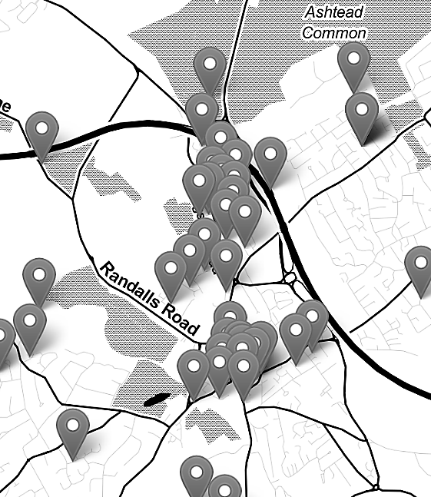

Mapping Crime Data in R: Live Code Demonstration
Nadia Kennar, Research Associate at the UK Data Service (Cathie Marsh Institute, UoM)
Copyright © year Institution. Created by Organisation, UK Data Service.

Slide 2
Code Demo - June 8th
Preliminary Tasks
Topic 1 – Exploring our crime data
Topic 2 – Shapefiles
Topic 3 – Combining census data (crime rate vs crime count)
Extra Topic – Interactive maps via Leaflet Package

Slide 3
Survey
When you leave the webinar, please complete our short survey
Just click on ‘continue’ to access the survey.

Slide 4
Thank You.
Email: nadia.kennar@manchester.ac.uk
Twitter: @NadiaKennar

